Slide 1
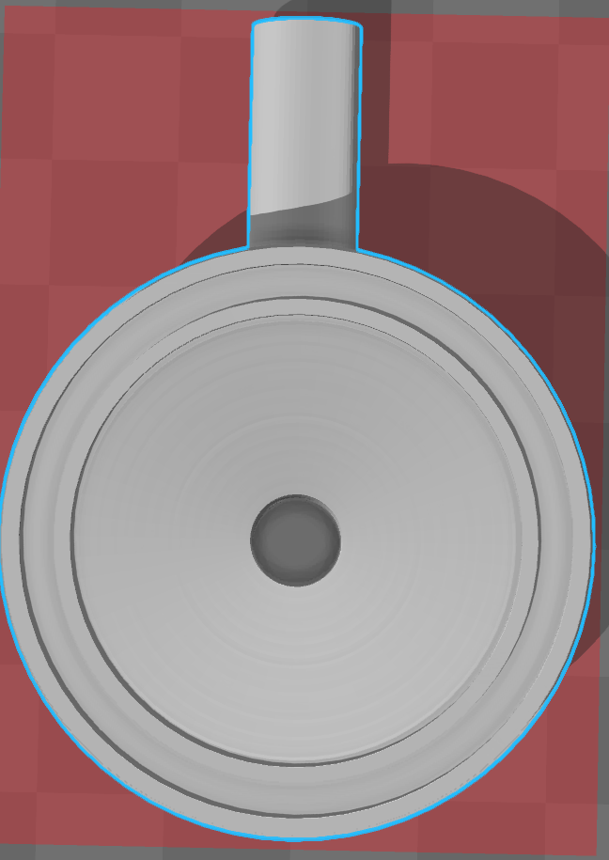

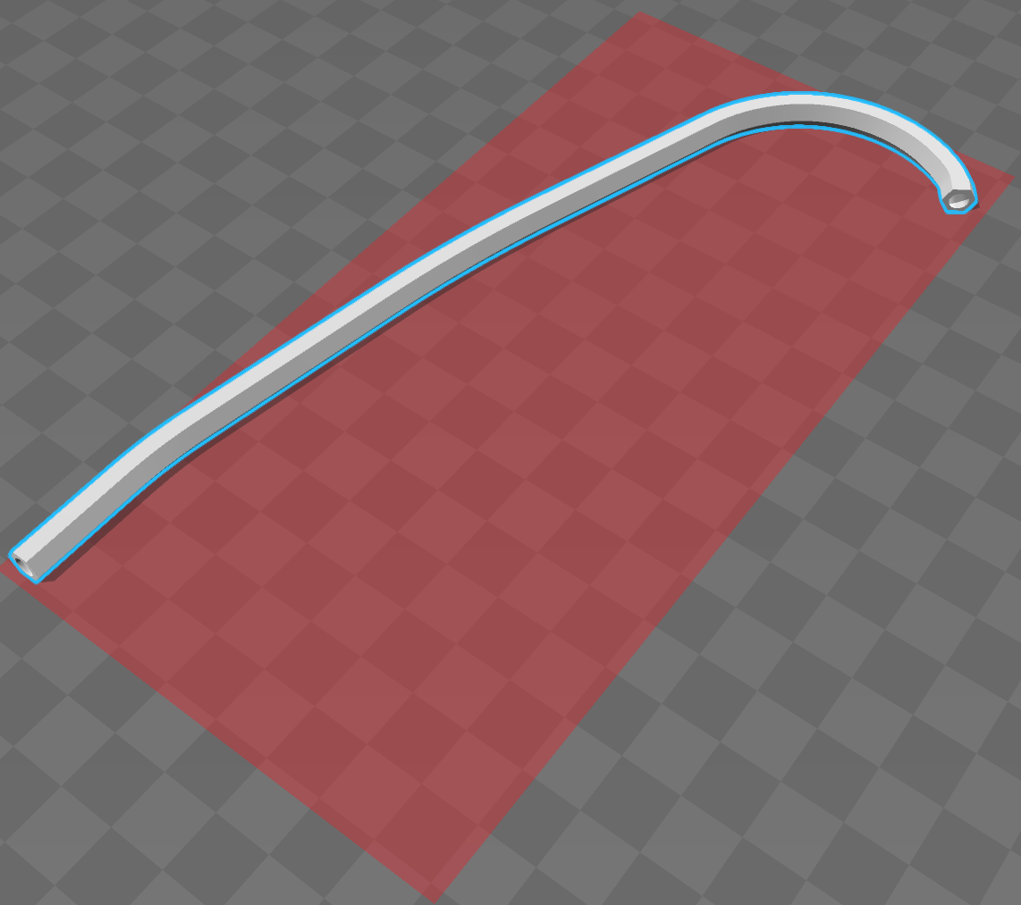
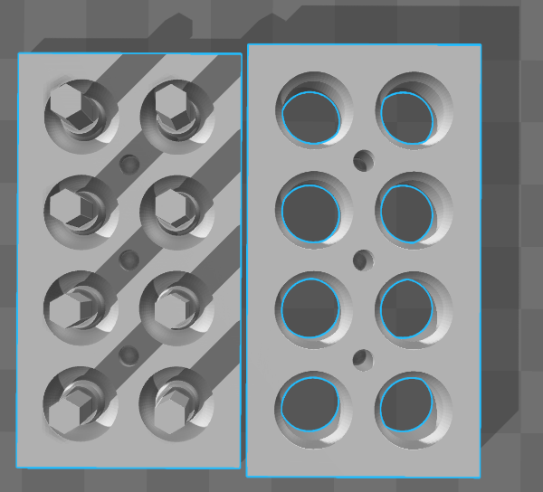
A.
B.
C.
Figure 1
Notes:
Figure 1. Computer aided design and assembly of the 3D printed stethoscope. Digital models of the 3D printed stethoscope parts are shown in Figure 1A. From left to right: the head, Y piece and ear tube are shown. An earplug mold design is also shown in Figure 1B. Each part was 3D printed in PLA, with the assembled stethoscope is shown in Figure 1C using the bill of materials listed in Table 1.

Slide 2
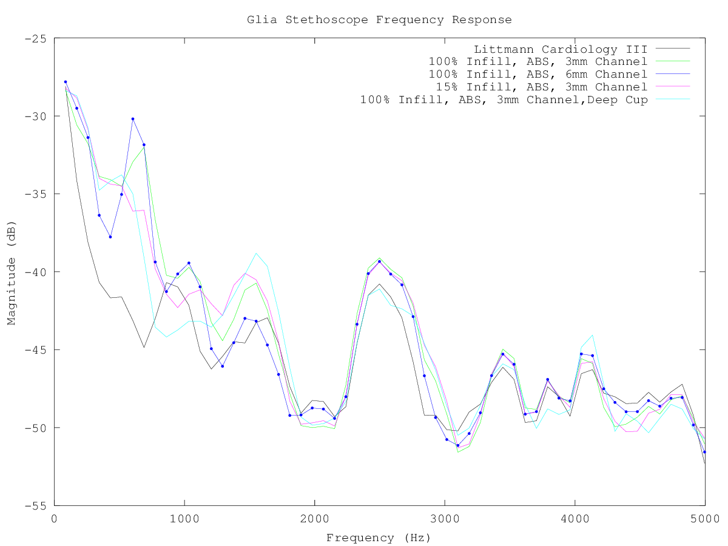
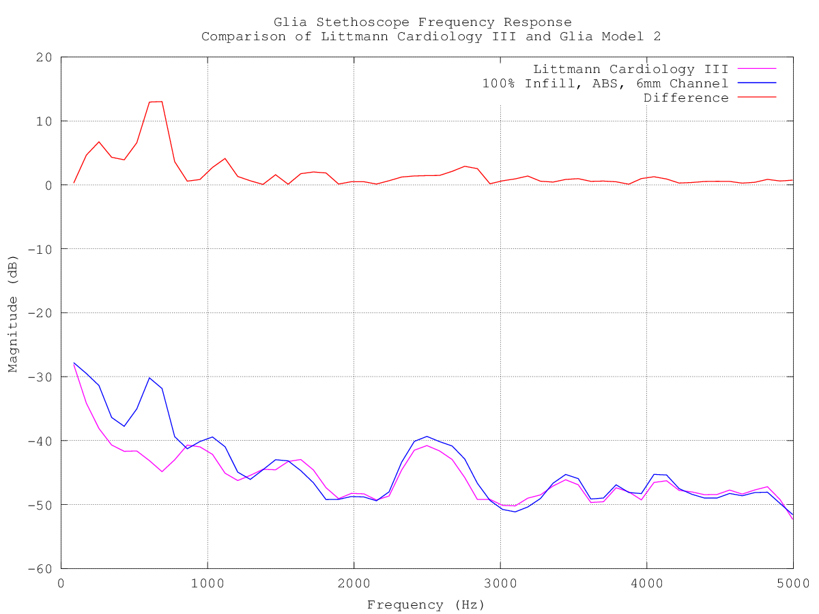
A.
B.
Figure 2
Notes:
Figure 2. Calibration and comparison of 3D printed Glia model stethoscopes to the gold standard Littmann Cardiology III. Stethoscope output responses were measured using the equipment setup described in the methods. Each stethoscope model recorded input sound at multiple frequencies and the change in amplitude between input and recorded sound was documented for each stethoscope (Figure 2A). Further comparison between the Glia Model 2 and the gold standard Littmann Cardiology III is shown in Figure 3B with the absolute Δmagnitude plotted above (Figure 2B).

